Slide 1


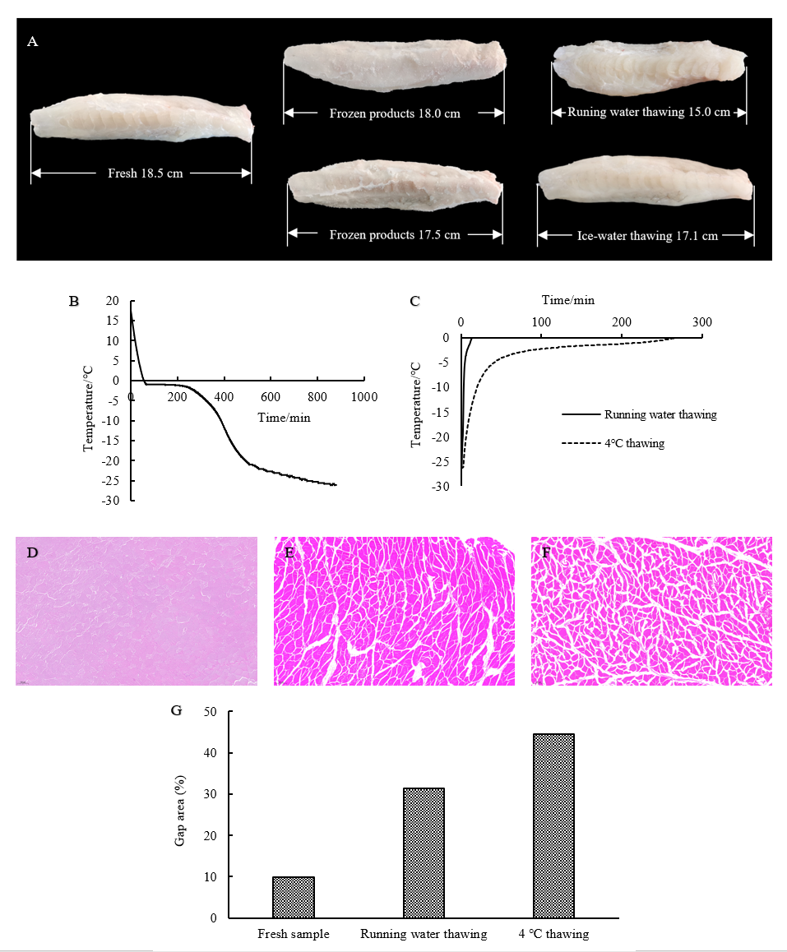
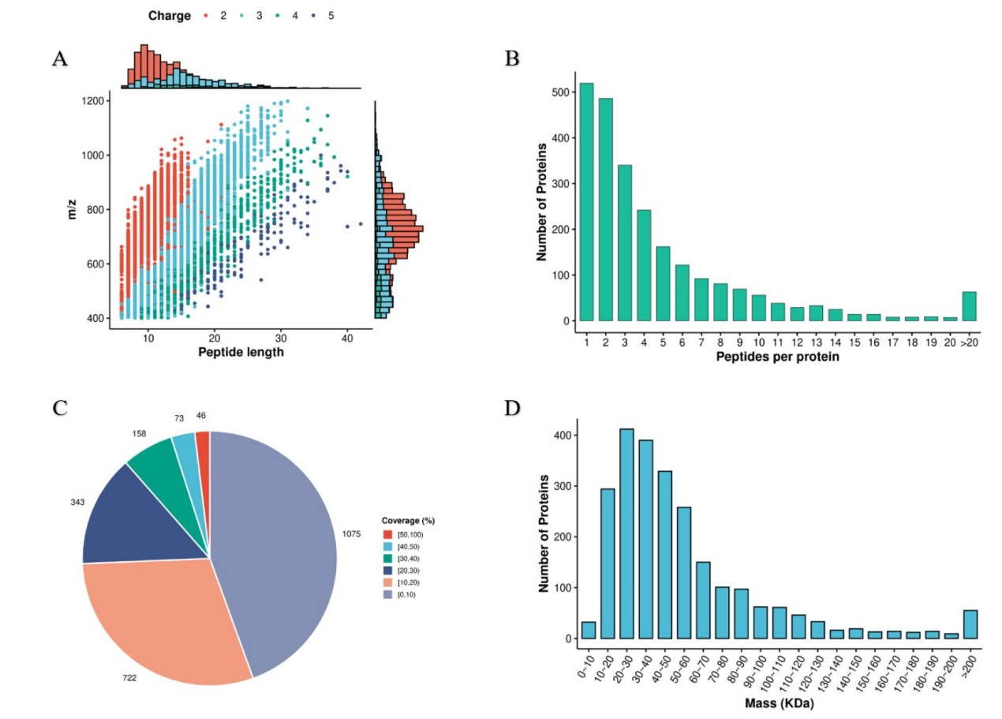
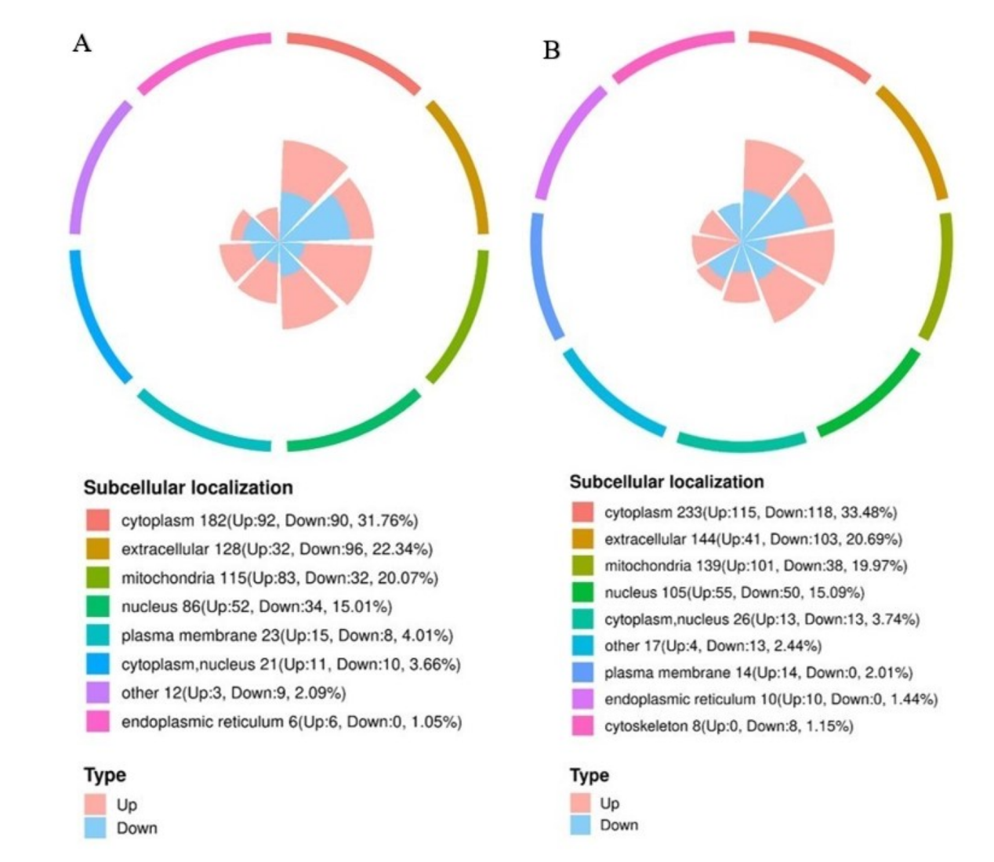
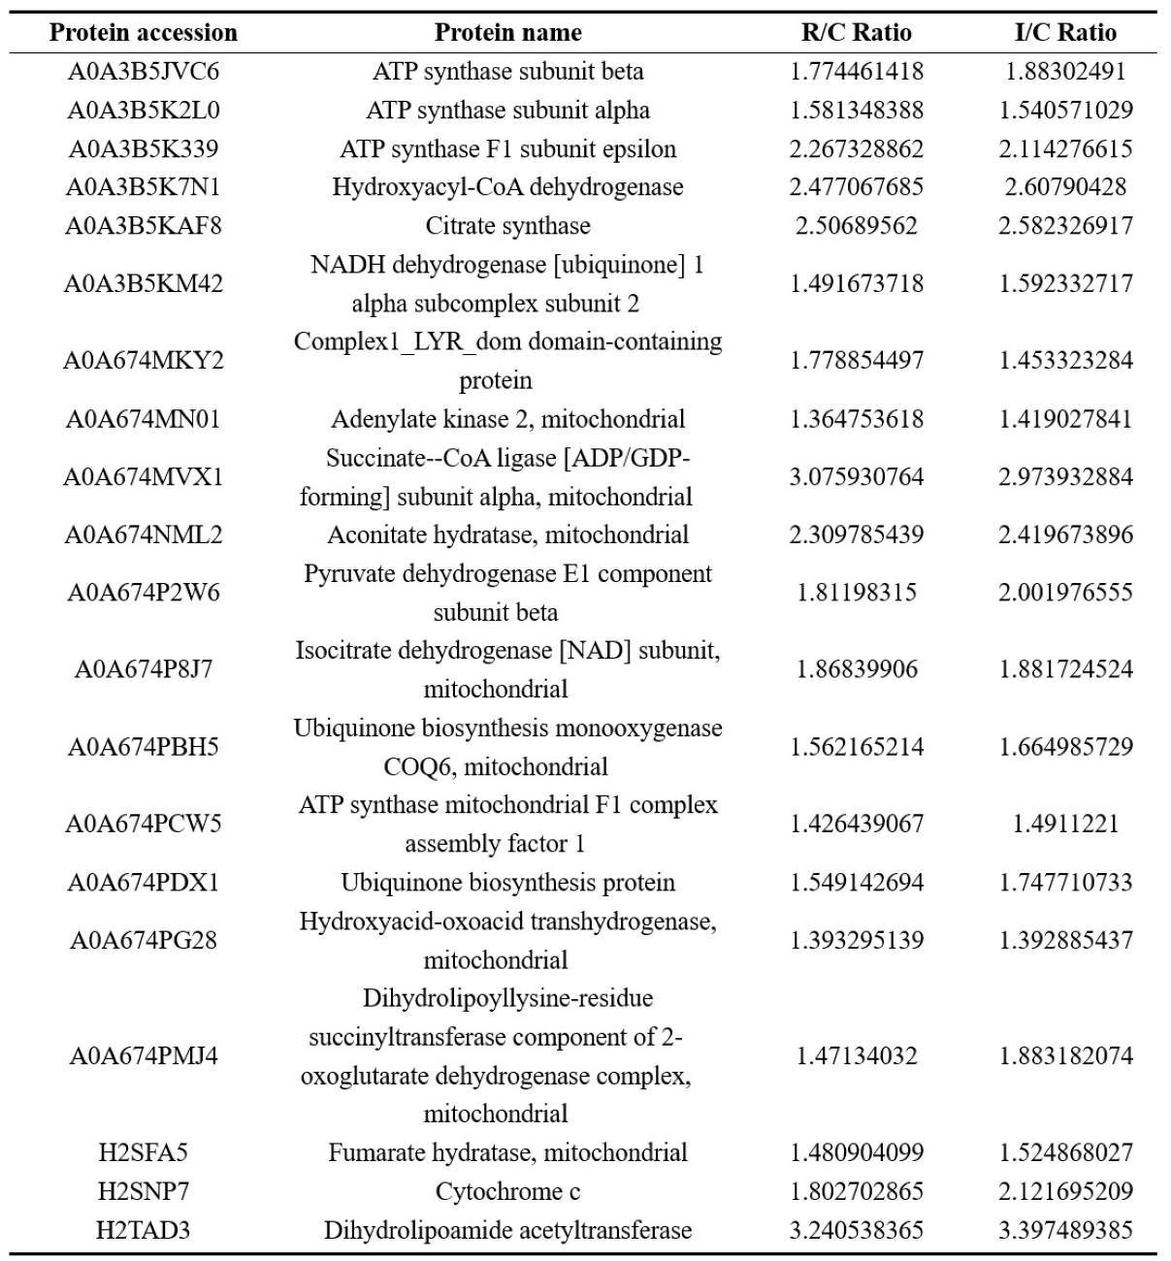
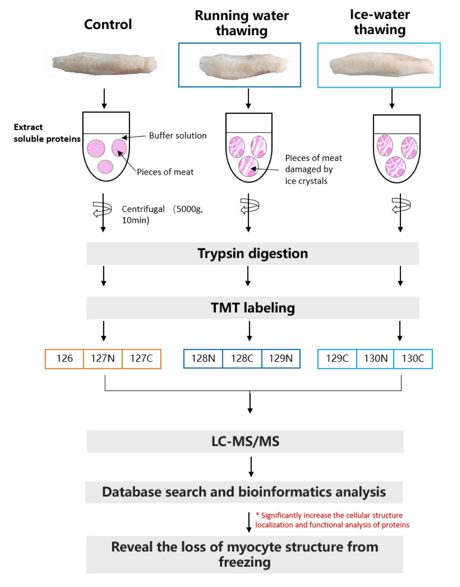
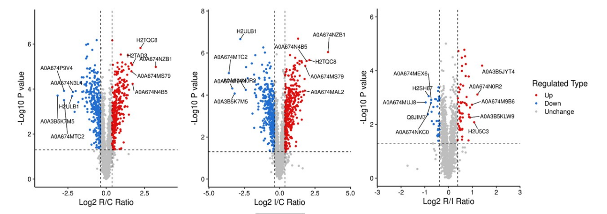
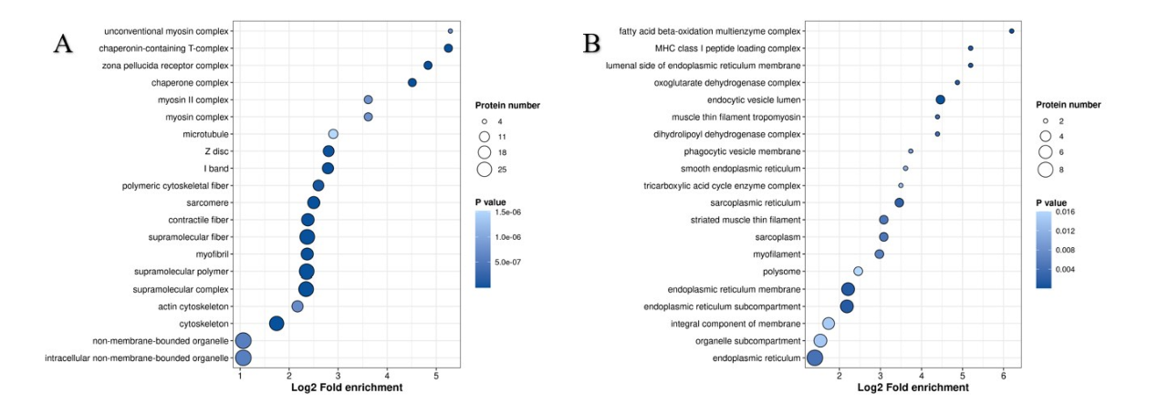
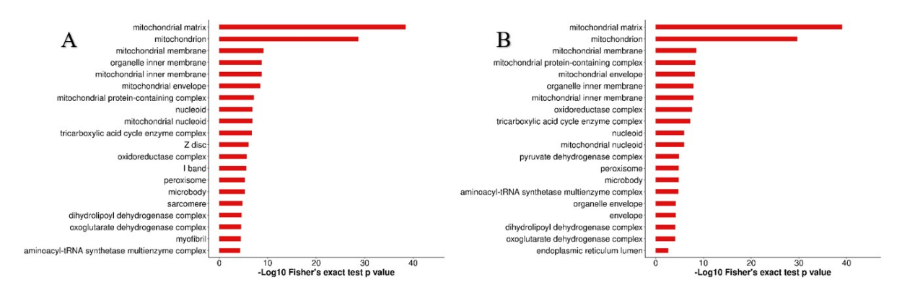
FSMILE 2025
Study on Thawing Markers of Takifugu rubripes Based on Extracted Liquid Proteomics
October 04-07, 2025
@Morioka & ZOOM Cloud
Lin Qi^{1,2}, Zhuolin Wang², Zhongzhuan Yin^{1,3}, Kaisheng Liu¹, Maninder Meenu⁴，Hang Lu¹, Hui Zhao¹, Chunhong Yuan^{2,5,6}, Yuanyong Tian^{1*}
1,College of Food Science and Engineering, Dalian Ocean University, Dalian 116023, China.
2,Faculty of Agriculture, Iwate University, Morioka, 020-8550, Japan.
3,Department of Food Science and Technology, Tokyo University of Marine Science and Technology, Tokyo, Japan
4,College of Biosystems Engineering and Food Science, Zhejiang University, Hangzhou 310058, China.
5,Faculty of Agriculture, Iwate University, Morioka, Japan
6,Agri - Innovation Center, Iwate University, Morioka, Japan
International Symposium on Food Communications and Sustainable Agri-Aqua Food Systems
Connecting Primary Industries, Academia, and Society through the SDGs
Contact Information:
1340665592@qq.com
Introduction
Takifugu rubripes primarily inhabits the coastal waters of northern and central China, as well as the coasts of Japan and Korea (Li et al., 2019). Freezing is the most commonly employed commercial preservation method not only for long-distance transportation but also for reducing food loss. However, during the freezing process, ice crystals increase the cytoplasmic concentration, accelerating protein denaturation, lipid oxidation, and other degradation reactions (Bao, Ertbjerg, Estévez, Yuan, & Gao, 2021; Nakazawa & Okazaki, 2020; Szymczak et al., 2020). These reactions are also closely related to the size of the ice crystals (Huizhu, 2018)
Results
Table 1. Differentially expressed mitochondria-related proteins.
Method
Experimental materials: Takifugu rubripes (1000–1100 g) were purchased from the New Changxing Seafood Market in Dalian, Liaoning Province. The live fish were anesthetized by qualified staff on ice. Slaughter was performed by severing the spine, and the samples were then placed in water at room temperature for 10 min to bleed out.
Freeze‒thaw treatments.
Morphological and optical microscopic structural changes in the fish fillets.
Proteomic analysis: The fish fillets were divided into three groups, each with three replicates , namely, the fresh control group (C), the rapid thawing group (R), and the slow thawing group (I). The fillets in groups R and I were frozen at −80℃ for 48 hours in plastic bags, followed by different thawing methods. For group R, the fillets were thawed in 18℃ running water until the center temperature of the fillets reached 0℃ . For group I, the fillets were thawed in ice water until the center temperature of the fillets reached 0℃ .
Fig. 3. Proteomic results of the Takifugu rubripes extract. A: Length distribution of identified peptides. B: Distribution of the number of peptides identified. C: Protein coverage of the Takifugu rubripes extract. D: Molecular weight distribution of the identified proteins in the Takifugu rubripes extract.
Fig. 5. Maps of differential protein subcellular structure localizations in each comparison group. A: R vs. C, B: I vs. C.
Fig. 2. Temperature curves and effects of muscle tissue structure on freeze‒thaw cycles in Takifugu rubripes. A: Comparison of morphological changes in fast- and slow-thawed Takifugu rubripes fillets. B: Freezing curve of Takifugu rubripes fillets. C: Thawing curve of Takifugu rubripes fillets. D-F: Microstructures of muscles in Takifugu rubripes subjected to different thawing methods. D: Cross-section of fresh Takifugu rubripes (100×), E: Cross-section of Takifugu rubripes thawed with running water (100×), F: Cross-section of Takifugu rubripes thawed at 4 °C (100×). G: Average gap areas in muscle tissue.
Fig. 4. Quantitative volcano plots of differentially expressed proteins in each comparison group.
Fig. 6. Bar plots of the GO enrichment of the enriched proteins related to cell composition. A: R vs. C, B: I vs. C.
Fig. 7. GO enrichment bubble diagram of cell composition-related differentially expressed proteins. A: Upregulated differentially expressed proteins; B: Downregulate differentially expressed proteins.
Conclusions
1. Rapid thawing caused more pronounced fillet contraction and greater disruption of myofiber structure; structural proteins (myofibrillar proteins, Z-lines, I-bands) were significantly increased in the rapid-thaw group.
2. Freezing–thawing overall increased extractable protein content and inflicted severe mitochondrial damage; differential proteins were enriched in energy-metabolism pathways (ATP synthase, NADH dehydrogenase, citrate synthase, aconitase).
3. Compared with rapid thawing, the slow-thaw group showed significant upregulation of pyruvate dehydrogenase and cytochrome c in the extracts, but experienced a broader loss of protein varieties.
4. Future work should clarify how the loss of these proteins influences muscle flavor and overall quality.
Fig. 1. Experimental design and workflow diagram for quantitative proteome analysis of the effluent sap of Takifugu rubripes using TMT labeling and LC‒MS/MS. Control: fresh control group (C). Running water thawing: rapid thawing group (R). Ice-water thawing: slow thawing group (I).
Acknowledgements
This work was supported by the General Project of the Department of Education of Liaoning JYTMS20230467; the General Project of the Department of Education of Liaoning JYTMS20230478; and the Science and Technology Plan Joint Fund of Liaoning 2023-MSLH-017.

